Slide 1
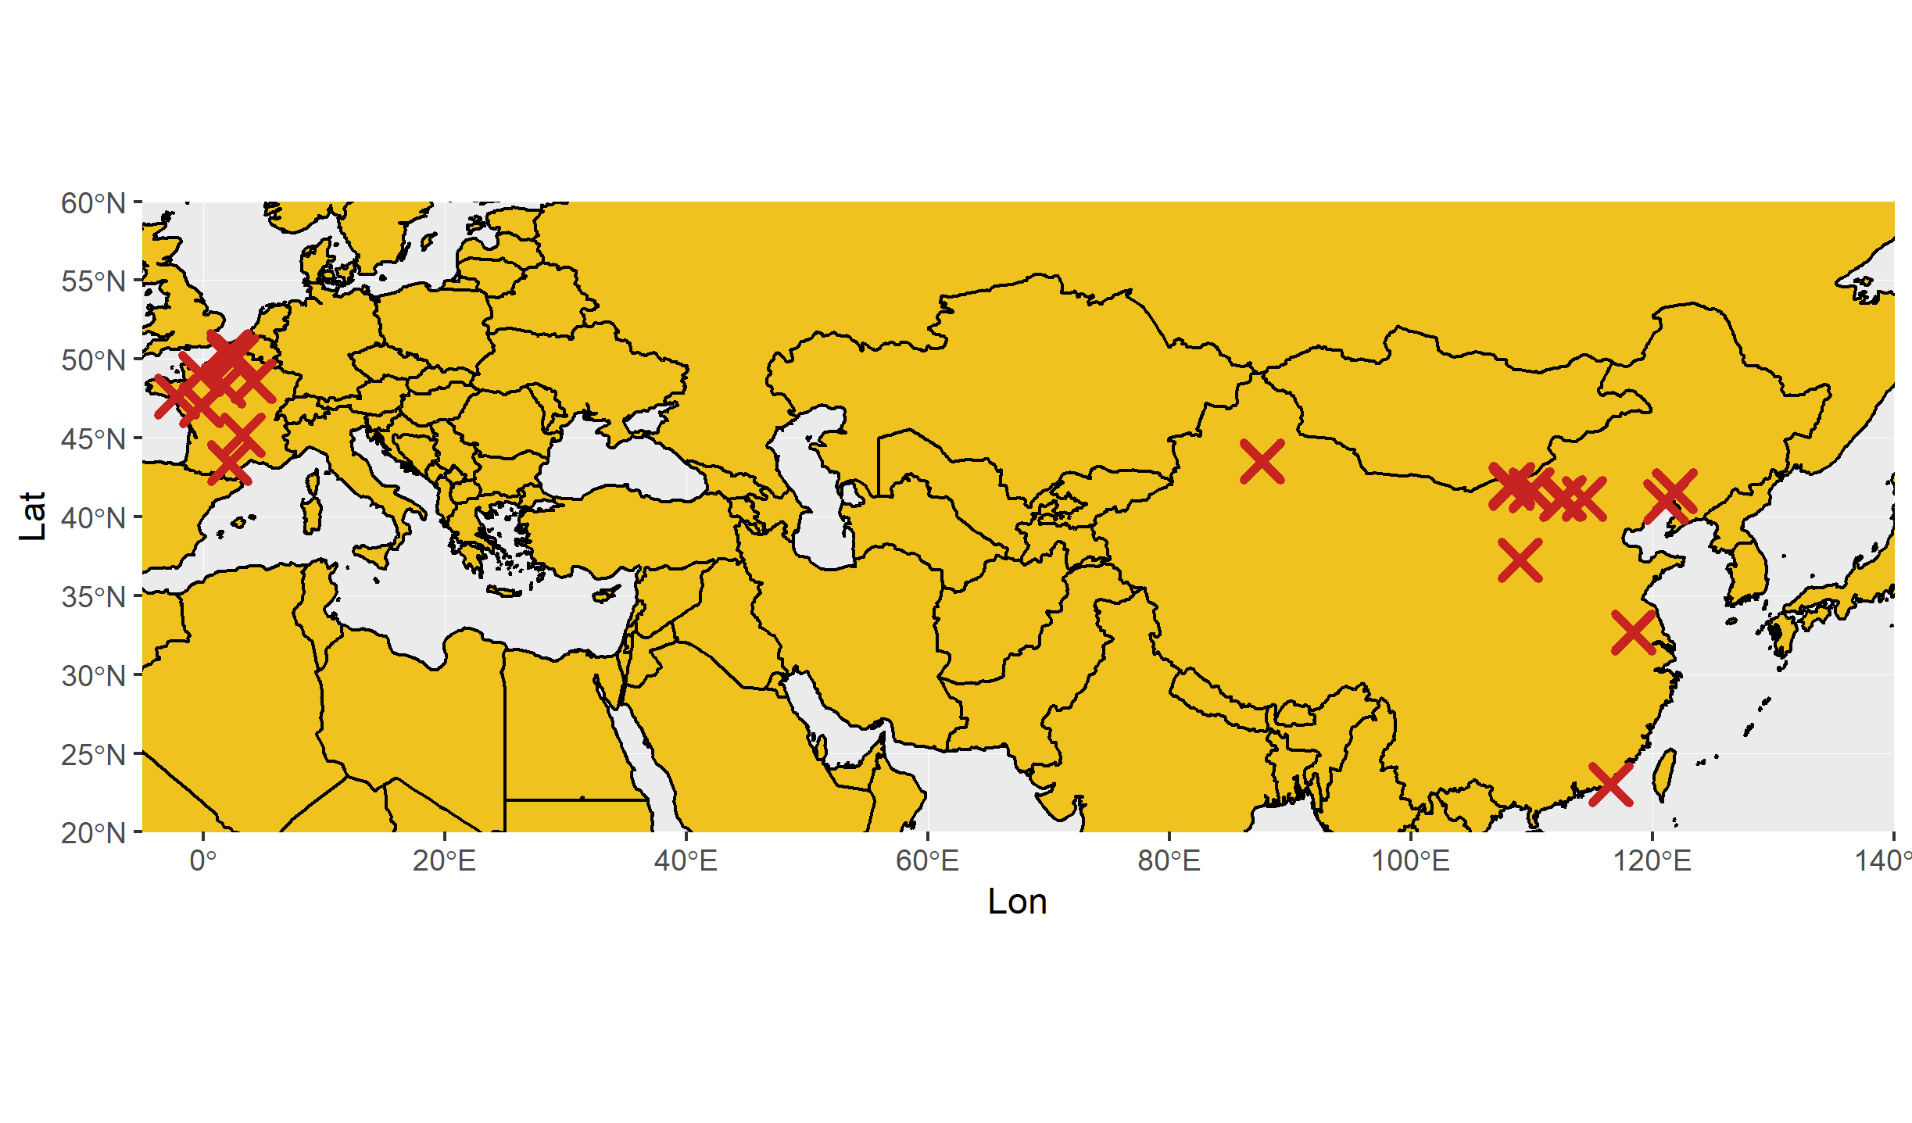
I found 331 wind turbines!

